Slide 1
Using Conceptual Models in Interaction Design
Interaction design consists of concepts, task flow, and presentation.
Concepts
e.g., all concepts that the application’s user interface exposes to users
-Task ﬂow
e.g., the sequence of operations that users execute to accomplish tasks
- Presentation
e.g., the controls, displays, etc. that comprise its user interface

Slide 2
Using Conceptual Models in Interaction Design (Contd.)
A conceptual model is a high-level description of an application.
It enumerates all concepts in the application that users can encounter, describes how those concepts relate to each other, and how those concept it into tasks that users perform with the application.
More precisely, a conceptual model of an interactive application includes, the data “objects,” which a user may encounter, and the “operations, attributes, and relationships, which a user may perform on the data objects.
It’s important to note that the conceptual model is independent of task ﬂ ow and presentation.
As you work out task ﬂow, you may ﬁnd problems in the conceptual model, and you may need to modify it.

Slide 3
Using Conceptual Models in Interaction Design (Contd.)
Lists are not models.
Sentences are not efﬁcient means of describing structure - Text is often redundant.
Node-link diagrams—concept maps—are a more efﬁcient means of representing conceptual models

Slide 4
Example of a conceptual model Johnson + Henderson – Alarm Clock
The clock stores the current time of day,
continually updating it to track the passage of time.
It displays the current time constantly.
Users can set the current time.
Users can set an alarm at a speciﬁed time, or no alarm.
When an alarm is set and the current time equals the set alarm time, the alarm is triggered.
Users can turn off an alarm.

Slide 5
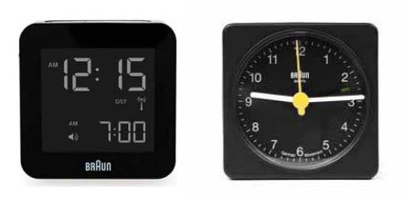
Example of a conceptual model Johnson + Henderson – Alarm Clock (Contd.)
could be expressed in digital or analog travel clocks.

Slide 6
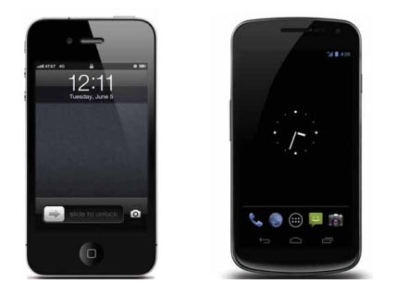
Example of a conceptual model Johnson + Henderson – Alarm Clock (Contd.)
could also describe the iPhone and Galaxy Nexus clocks.

Slide 7
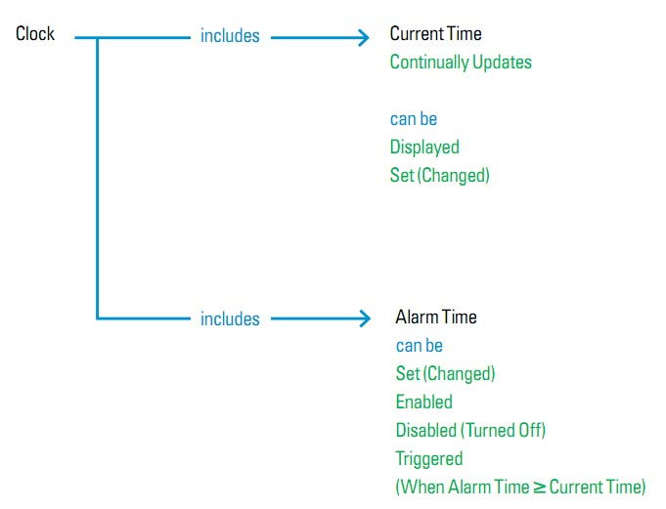
Example of a conceptual model Johnson + Henderson – Alarm Clock (Contd.)
A conceptual model of an alarm clock represented as a concept map.

Slide 8
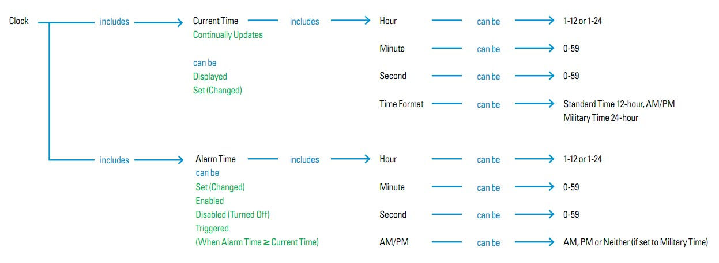
Example of a conceptual model Johnson + Henderson – Alarm Clock (Contd.)
Conceptual model of an alarm clock with detail added.

Slide 9
Summary
Product teams should agree on a conceptual model—a deﬁnition of what users need to know—well before creating wire-frames and writing code.
The model will change over the course of the product development process.
Developing a standard form for conceptual models will make them easier to understand, easier to make, and easier to teach new designers.

Slide 10
References & Further Reading
http://www.dubberly.com/presentations/conceptual_models.pdf
Conceptual Models: Begin by Designing What to Design by Jeff Johnson and Austin Henderson

